Slide 1
Cisco Intersight Workload Optimizer (IWO)
Ordering Guide
November 2021

Slide 2
Intersight Workload Optimizer (IWO)
WHAT’S COVERED?
Buying models
A-la-carte
DC EA
Starter Packs
IWO price tiers
Quoting & Ordering
CX Offers
SFDC Tagging
See Table of Contents on slide 4 to navigate to the section of interest
For details on ordering Intersight (instead of IWO) you can find the Intersight ordering guide in the ”Propose” section on the Intersight SalesHub here: https://salesconnect.cisco.com/#/program/PAGE-15502

Slide 3
IWO FAQ
Q: Do I need Intersight in order to get IWO?
A: No – Intersight is not a ”requirement” for a customer to license IWO although it is a desired state. The only thing an IWO customer needs is no cost login credentials to Intersight and those credentials will provide access to IWO.
Q: If I purchase Intersight, do I automatically get IWO?
A: No – IWO is a separately chargeable product and does not come “free” with any tier of Intersight.
Q: Can I ”upgrade” from Intersight to IWO?
A: No – Intersight and IWO are different products delivering different value to our customers – IWO is a feature set that is considered an “add-on” to Intersight that has an additional cost.

Slide 4
Cisco Intersight Workload Optimizer
What’s in this ordering guide?
In this ordering guide, you will find information that will help you build quotes for Cisco Intersight Workload Optimizer (IWO) and understand the various consumption models available to Cisco sellers, our Partners and most importantly, our Customers.
Introduction to Cisco Intersight Workload Optimizer slide 5
Pricing, Discounting & Ordering Slides (VSI & VDI) slide 9
Quoting & Ordering slide 18
Ordering IWO as part of the Data Center EA slide 31
How to get EVAL/PoV, NFR, & Internal Lab software slide 33
Discount exception request process slide 49
Deployments services for IWO slide 58
Tagging IWO opportunities in SFDC slide 61
If you have any questions about this ordering guide, please direct them to ask-cwom@cisco.com

Slide 5
Cisco Intersight Workload Optimizer
What is Cisco Intersight Workload Optimizer (IWO)? Cisco® Intersight Workload Optimizer is a SaaS delivered decision engine that drives continuous health in dynamic data center environments, whether on-premises or in a public cloud. The real‑time decision engine provides automatable actions that adjust infrastructure resources at every layer of the stack to ensure the performance of applications at the lowest possible cost.
Customer Benefits
Safely increase infrastructure utilization
Eliminate infrastructure as the cause of application performance degradation, without overprovisioning
Optimize public cloud spend
Consume and pay only for what the business really needs
Accelerate and de-risk multicloud projects
Safely and efficiently migrate workloads between premises and the public cloud to reduce cost and increase efficiency
Improve IT staff productivity
Simplify complex tasks, automate decision-making, and gain time to innovate
Accelerate consolidation and refresh projects
Accelerate and de-risk IT transformation projects across heterogeneous estates

Slide 6
Target customers and use cases
Target customers
Medium to large enterprise customers with:
Application-performance issues
Out of control Public Cloud spend
Multicloud management challenges
500 vms/workloads or more
Under-utilized infrastructure
Infrastructure refresh planning
Targeted use cases
Optimize data center and private cloud environments
Ensure workload performance while minimizing public cloud costs
Optimize data center consolidation and hardware-refresh projects
Primary buyers and technical influencers
CIO (economic buyer) Responsible for all of IT. Has a mandate to “automate everything” in order to drive IT speed and agility, transform the business, and minimize costs
Data center manager (technical buyer) Infrastructure and operations lead. Needs to ensure that business users have the technology they need to do their jobs more efficiently, securely, and cost-effectively. That means making sure their applications and data are always available to them and don’t slow them down

Slide 7
Cisco Intersight Workload Optimizer
Ordering Guide Updates
This is a NEW ordering guide based on IWO SaaS initial orderability
Pricing is based on Workloads (VMs) managed either on-premises or in the public cloud
Subscription model only – (There is NO perpetual model for ordering IWO)
IWO is a “core” suite in the Data Center Enrollment in the Cisco Enterprise Agreement (EA)
EVAL, NFR and Internal Lab license request process – all new
For Sales Materials on IWO including assets and videos, please go to the IWO SalesHub on SalesConnect here: https://salesconnect.cisco.com/#/program/PAGE-17421
Please check SalesConnect regularly to be sure you have the latest version of all assets including this ordering guide!

Slide 8
Cisco Intersight Workload Optimizer
What are the IWO consumption models available on Cisco GPL today?
Transactional using DC-MGT-SAAS
As part of the DC Enrollment for the Cisco Enterprise Agreement (DC EA)
IWO Starter Packs (Coming in Q4. See slide 42)

Slide 9
Cisco Intersight Workload Optimizer Pricing, Discounting & Ordering

Slide 10
Cisco Intersight Workload Optimizer
Pricing, discounting and ordering – KEY POINTS
IWO is available as a subscription model only
Durations are from 12-60 months
Payment options include prepaid, annual, quarterly and monthly (all based on 12 to 60 month commitments)
Subscription pricing includes support. No separate support purchase required
For Enterprise Agreements, see the new information on the Data Center Enrollment for the Cisco Enterprise Agreement here: https://salesconnect.cisco.com/#/program/PAGE-14313
Cisco Market Category Pricing/Discounting guidelines apply
Partners will receive 20% discount as standard
Partners will receive an additional 10% discount for registered deals (OIP) for a total of 30%
Partners can also leverage VIP for IWO
In order to request any other non-standard discount approval, follow the DRP exception process in the ordering guide, see slide 60 for DRP exception process

Slide 11
Cisco Intersight Workload Optimizer- Ordering
Notes on Partner limitations for subscription durations:
No restrictions for any partner ordering duration between 12 and 60 months
Any term less than 12 months will require Cisco AM approval
Co-terming with pre-existing IWO subscriptions is allowed

Slide 12
Intersight Workload Optimizer – VM Pricing START with DC-MGT-SAAS Workload List Pricing – Per VM/Workload (estimated prices - see CCW for exact price)
IWO Tier | Quantity Level VMs/Workloads | 1yr Subscription Per VM/Workload | 3yr Subscription Total/Per VM/Workload | 5yr Subscription Total/Per VM/Workload
Essentials DC-MGT-WO-SAAS-ES | 1 – 2,000 | $145 | $392 ($131/VM/YR) | $580 ($116/VM/YR)
Essentials DC-MGT-WO-SAAS-ES | 2,001 + | $113 | $305 ($102/VM/YR) | $452 ($90/VM/YR)
Advantage DC-MGT-WO-SAAS-AD | 1 - 2,000 | $210 | $568 ($189/VM/YR) | $841 ($168/VM/YR)
Advantage DC-MGT-WO-SAAS-AD | 2,001+ | $164 | $443 ($148/VM/YR) | $656 ($131/VM/YR)
Premier DC-MGT-WO-SAAS-PR | 1 - 2,000 | $252 | $681 ($227/VM/YR) | $1,009 ($202/VM/YR)
Premier DC-MGT-WO-SAAS-PR | 2,001+ | $197 | $531 ($177/VM/YR) | $787 ($157/VM/YR)
Prices on this table are in USD

Slide 13
Intersight Workload Optimizer – VDI Pricing START with DC-MGT-SAAS Workload List Pricing – Per VDI/Workload (estimated prices - see CCW for exact price)
IWO Tier | Quantity Level Number of VDI | 1yr Subscription Total Per VDI | 3yr Subscription Total Per VDI | 5yr Subscription Total Per VDI
Essentials DC-MGT-WOD-SAAS-ES | 1 – 2,000 | $48 | $131 ($44/VDI/YR) | $193 ($39/VDI/YR)
Essentials DC-MGT-WOD-SAAS-ES | 2,001 + | $38 | $102 ($34/VDI/YR) | $151 ($30/VDI/YR)
Advantage DC-MGT-WOD-SAAS-AD | 1 - 2,000 | $70 | $189 ($63/VDI/YR) | $280 ($56/VDI/YR)
Advantage DC-MGT-WOD-SAAS-AD | 2,001+ | $55 | $148 ($49/VM/YR) | $219 ($44/VDI/YR)
Premier DC-MGT-WOD-SAAS-PR | 1 - 2,000 | $84 | $227 ($76/VDI/YR) | $337 ($67/VDI/YR)
Premier DC-MGT-WOD-SAAS-PR | 2,001+ | $66 | $177 ($59/VDI/YR) | $262 ($52/VDI/YR)
Prices on this table are in USD

Slide 14
Cisco Intersight Workload Optimizer
Cisco IWO Tier Name | Turbo Edition Name
Essentials | Advanced
Advantage | Premier
Premier | Platinum
How do Cisco’s Tiers compare to Turbonomic’s Editions?

Slide 15
Cisco Intersight Workload Optimizer Features – All TIERS have AUTOMATION….
Feature | Essentials | Advantage | Premier
Workloads Limit (VMs or Public Cloud Instances ) | Unlimited | Unlimited | Unlimited
Public Cloud / Instances | P | P | P
On Premises / Hypervisors (Cisco UCS & Non UCS Compute) | P | P | P
Hyperconverged (Cisco HX and Non HX) | P | P | P
Storage, Network Aware, VDI | P | P | P
Application Performance Monitoring (APM) Integration (AppDynamics only) |  | P | P
Container Pod Horizontal & Vertical Scaling, Rightsizing, Redistribution |  | P | P
Database Servers (Oracle, MSFT SQL, MySQL, …) and Databases Services (Azure SQL, AWS RDS, …) * |  | P | P
Application Server/JVM (Tomcat, Websphere, …) |  | P | P
Workflow Integration (ServiceNow, … )* |  | P | P
Native Orchestration, Infra as Code Integration (Ansible,Terraform, CloudFormation, … ) (late Q4, Q1 FY22) |  | P | P
* Coming soon – Refer to Target Config Guide for supported targets

Slide 16
Cisco Intersight Workload Optimizer Features – All TIERS have AUTOMATION….
Feature | Essentials | Advantage | Premier
Application Performance Monitoring (APM) Integration (Dynatrace, New Relic, AppInsights, Datadog..) * |  |  | P
Application Performance Extensibility (APEX) Ingest, Correlate, Visualize Custom Metrics, Events, Logs, and Traces (New) |  |  | P
360-degree perspective for all Staff: Business, App/Dev, SRE, CloudOps and IT (New) |  | P (with AppD) | P
AI-Driven Application Resourcing (New) |  | P (with AppD) | P
* Coming Soon – Refer to Target Config Guide for supported targets

Slide 17
Cisco Intersight Workload Optimizer
Which tier is right for your customer?
Every tier of IWO supports the same core functionality and cover the same environments. Core functionality includes the ability to discover and represent performance profiles and recommended actions. Automated Placement and Scaling actions are available in all tiers. All tiers allow for the use of compliance policies that may be user-defined to align with business objectives. All editions support managing workloads running in local virtualized environments and in both Amazon and Microsoft public clouds as well as Kubernetes container environments.
Essentials - Customers who are focused on hybrid cloud infrastructure optimization and automation will find that the Essentials tier of IWO will be perfect for them. Essentials supports both on premises and public cloud optimization, is hypervisor agnostic, supports converged and hyperconverged stacks and storage and network systems integrations and actions.
Advantage – This tier adds container scaling, rightsizing and redistribution, database server and services support application server support, workflow integration and Cisco AppDynamics APM integration. Finally, you will see native orchestration, infrastructure as Code Integration (Ansible, Terraform, CloudFormation, … ) coming soon!
Premier – IWO Premier is for customers that want application resource management and integration with APM (other than AppD which is in IWO Advantage) and open source APM solutions to provide application performance extensibility, correlation and visualization. Customers will also get 360-degree perspective for all staff and AI-Driven Application Resourcing. Packaged APM product supported include Dynatrace, New Relic, App Insights and Datadog. (Reminder that AppD integration is provided in IWO Advantage)

Slide 18
Cisco Intersight Workload Optimizer Quoting & Ordering

Slide 19

Before ordering …
Please collect all mandatory customer information

Slide 20
Required customer details before placing order ….
 | Customer specific detail for placing Cisco Intersight Essential purchase order | Why ?
1 | End customer’s “Cisco Smart Account” & ”Virtual account” name | Cisco Intersight Workload Optimizer licenses are deposited into customer Smart Account + Virtual account
2 | “Shipping & Install” - End customer’s email-id | Allows End Customer (user) to access Cisco’s eDelivery, licenses, legal documents and self provision for Cisco Intersight Workload Optimizer SaaS
3 | “Billing contact” – for Cisco Intersight Workload Optimizer subscription billing | Subscription billing for the duration of subscription
4 | CCO user id for at least one End Customer – users expected to use Cisco Intersight Workload Optimizer SaaS portal from www.intersight.com | CCO userid + Cisco Smart Account is used to provision access to Cisco Intersight – Workload Optimizer SaaS features

Slide 21
For more info …
Cisco Smart Accounts:
https://www.cisco.com/c/en/us/buy/smart-accounts.html
Setup Cisco Smart Account for your customer, if they don’t have one:
https://www.cisco.com/c/en/us/products/software/smart-accounts.html#~stickynav=2
Cisco Smart Licensing:
https://www.cisco.com/c/en/us/buy/smart-accounts/software-manager.html
Cisco SaaS / Cloud Subscription Management – Partner training PDF
https://forums.cisco.com/servlet/fileField?entityId=ka21C000000E27BQAS&field=Attachment__Body__s

Slide 22
Cisco Intersight Workload Optimizer offer and PIDs
Mandatory ➔ Cisco Smart Accounts & Smart Licensing
Discount Restriction ➔ Market Category, maximum 20% discount
Annuity / Subscription Offer – Default is 36 months; allows 12 to 60 months
Higher Quantity and Longer Subscription Terms offer best price for customers
Quantity Tiers (2): 1 – 2,000, 2,001 and above (meter is VMs or Workloads)
Subscription Durations: 12 to 60 months
IWO PIDs can be selected along with core Intersight PIDs if needed
Orderable PID | Description
DC-MGT-SAAS | Cisco Intersight – Product Family
DC-MGT-WO-SAAS-ES | Cisco Intersight Workload Optimizer – Essentials VM
DC-MGT-WOD-SAAS-ES | Cisco Intersight Workload Optimizer – Essentials VDI
DC-MGT-WO-SAAS-AD | Cisco Intersight Workload Optimizer – Advantage VM
DC-MGT-WOD-SAAS-AD | Cisco Intersight Workload Optimizer – Advantage VDI
DC-MGT-WO-SAAS-PR | Cisco Intersight Workload Optimizer – Premier VM
DC-MGT-WOD-SAAS-PR | Cisco Intersight Workload Optimizer – Premier VDI

Slide 23
Cisco Intersight Workload Optimizer - Ordering
Quick steps to order IWO:
Enter DC-MGT-SAAS in CCW and click Add
Select the pencil icon by Requested Start Date
Select options on all four below and then click Apply
Requested Start Date desired (only needed when ordering)
End date /duration
Turn Auto-renewal “On” or “Off”
Billing Frequency desired
Select Cisco Intersight Workload Optimizer (IWO) – SaaS
Select DC-MGT-WO-SAAS-ES for IWO Essentials or DC-MGT-WOD-SAAS-ES for IWO Essentials VDI
Select DC-MGT-WO-SAAS-AD for IWO Advantage or DC-MGT-WOD-SAAS-AD for IWO Advantage VDI
Select DC-MGT-WO-SAAS-PR for IWO Premier or DC-MGT-WOD-SAAS-PR for IWO Premier VDI
Select desired quantity in VMs or VDI (tiered pricing for quantity and duration will auto calculate for all editions)
Select done to complete

Slide 24
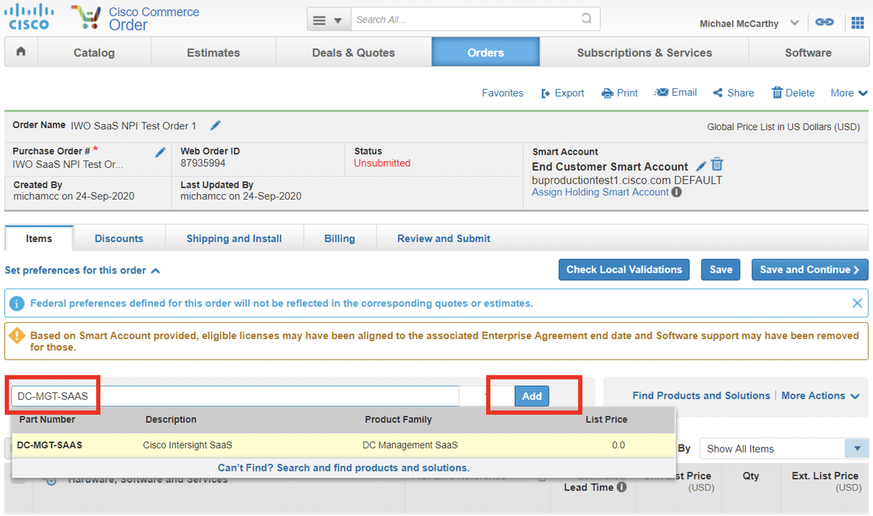
Cisco Intersight Workload Optimizer - Ordering
Enter DC-MGT-SAAS in CCW and select Add

Slide 25
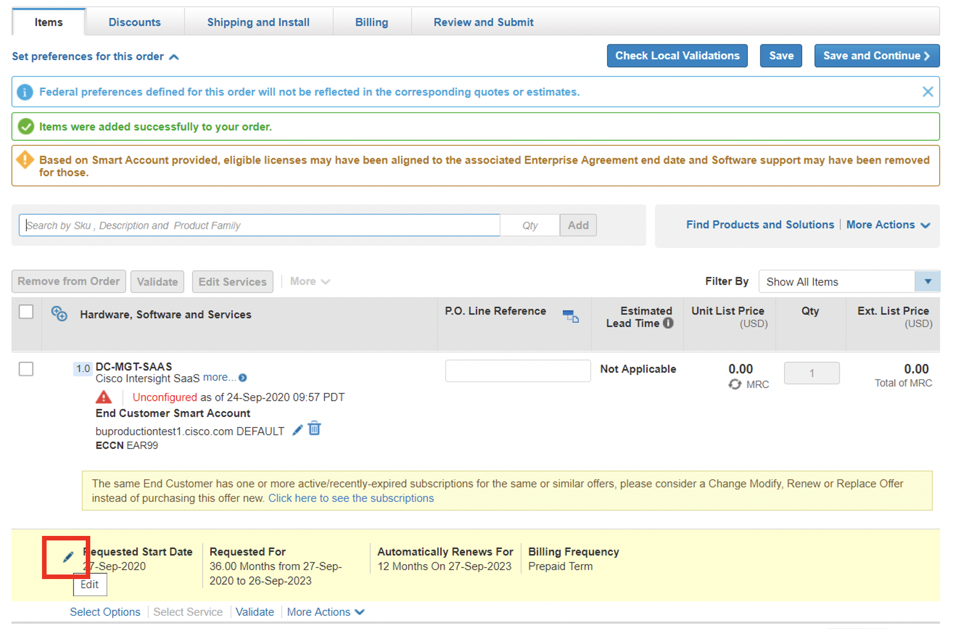
Cisco Intersight Workload Optimizer - Ordering
Click on Requested Start Date

Slide 26
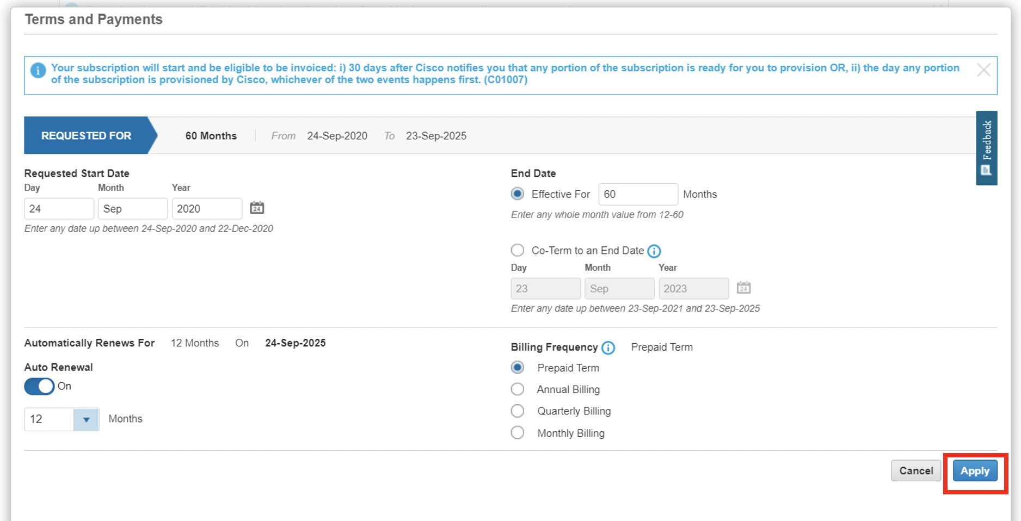
Cisco Intersight Workload Optimizer - Ordering
Enter Requested Start Date (for ordering only), End Date (duration in months), Auto Renewal (on/off) and Billing Frequency option

Slide 27
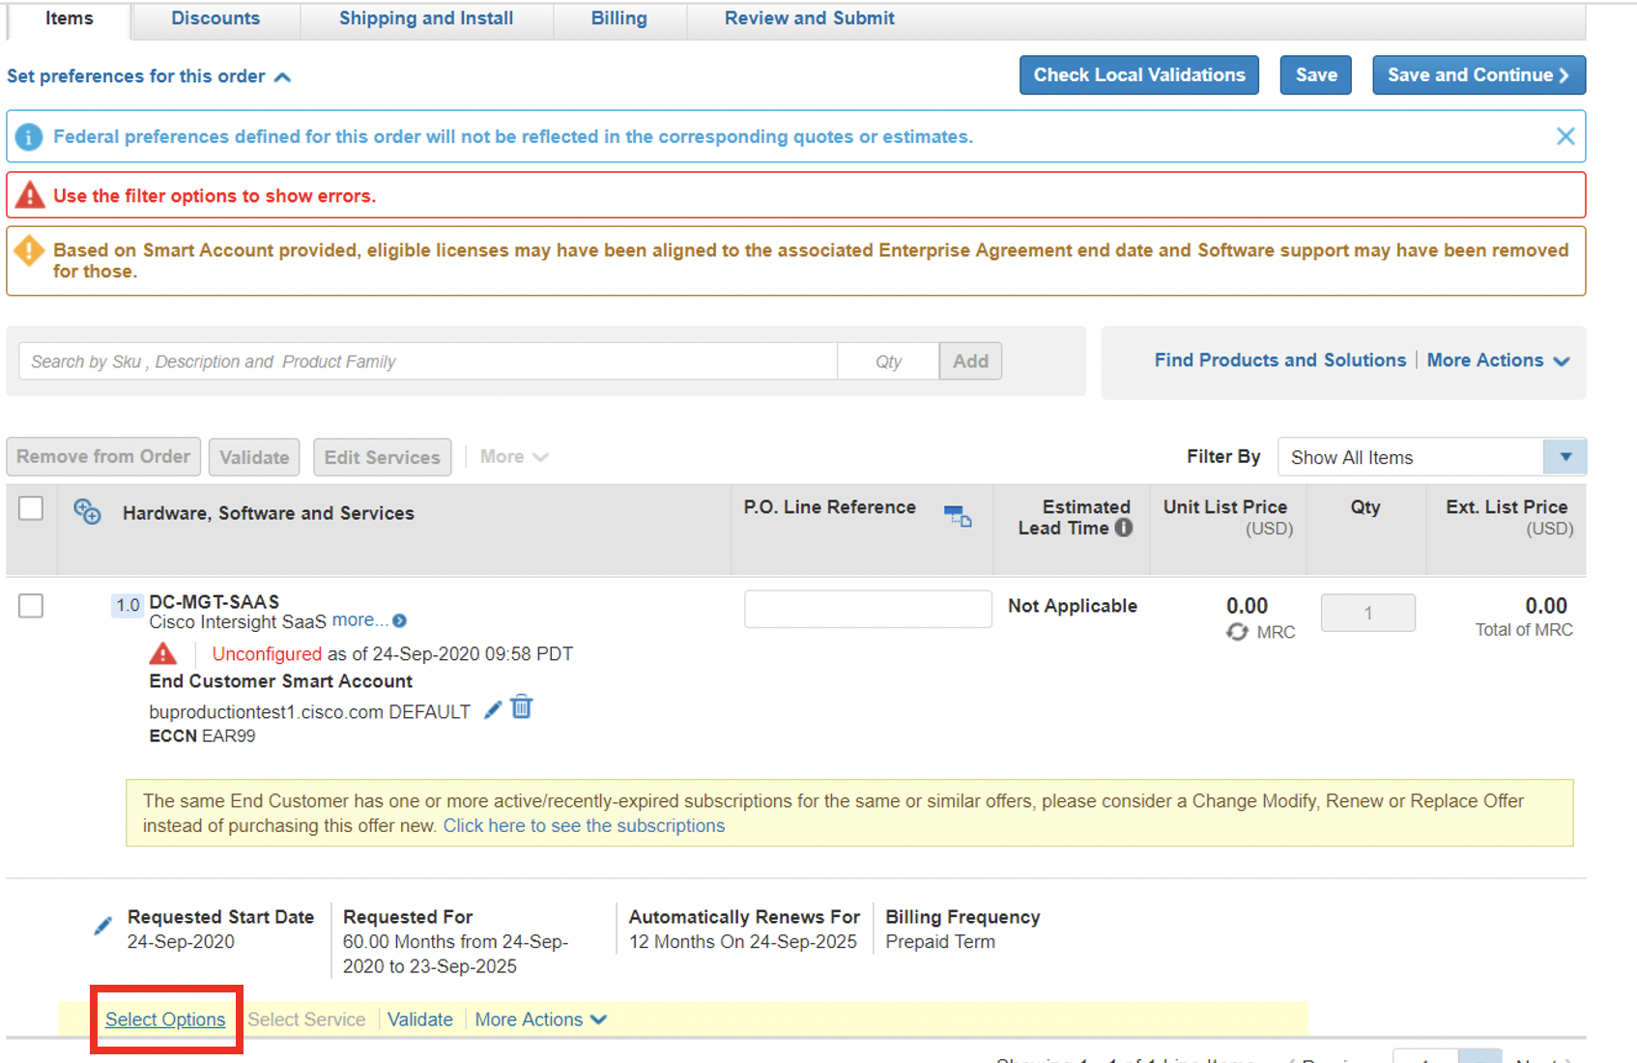
Cisco Intersight Workload Optimizer - Ordering
Choose Select Options to start configuring your IWO estimate/quote/order

Slide 28
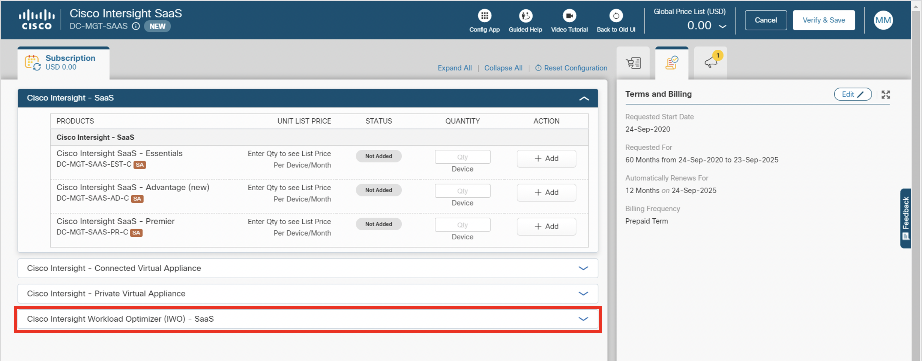
Cisco Intersight Workload Optimizer - Ordering
Select Cisco Intersight Workload Optimizer (IWO) – SaaS on the left panel. Note that the Terms and Billing details are highlighted on the right panel!

Slide 29
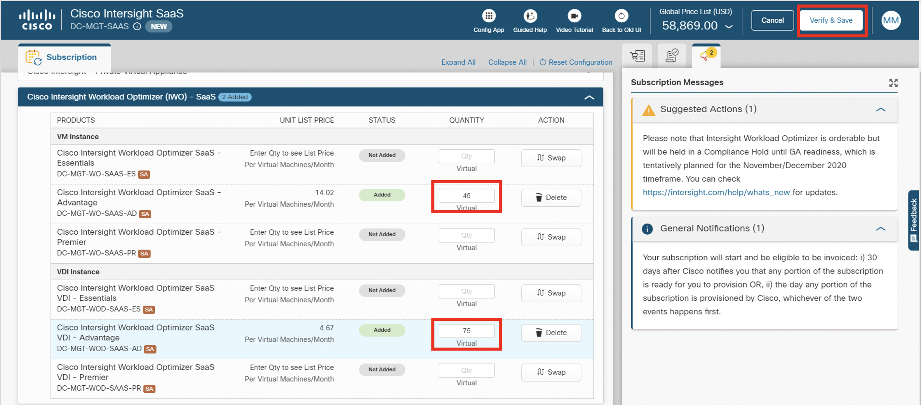
Cisco Intersight Workload Optimizer - Ordering
Select the tier and type from the left panel. In this example we have chosen 45 VM licenses for Advantage and 75 VDI licenses for Advantage. Then select Verify & Save
Note: You can select VM quantities only or VDI quantities only as well.
Quantities are independent of each other.
You can only choose one tier when ordering both VM and VDI.

Slide 30
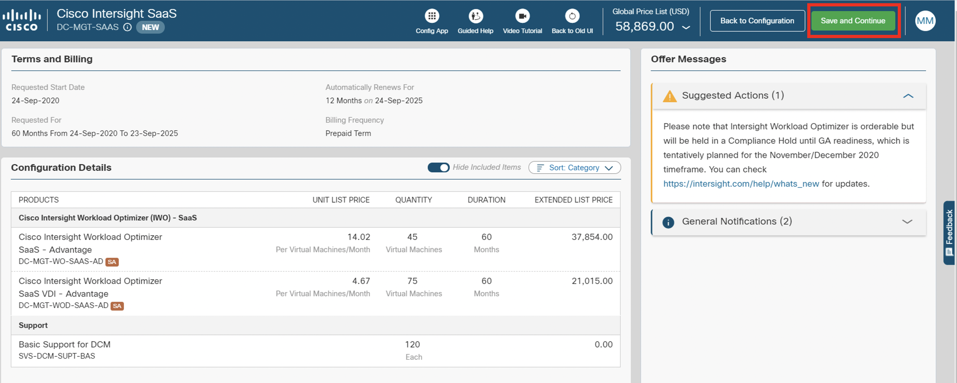
Cisco Intersight Workload Optimizer - Ordering
Completed, orderable configuration for 45 VM licenses Advantage, 75 VDI Licenses Advantage for 60 months – prepaid – click Save and Continue to continue

Slide 31
Cisco Intersight Workload Optimizer Ordering IWO in the Data Center EA

Slide 32
Cisco Intersight Workload Optimizer - Ordering
How to order IWO when ordering via the Data Center Enrollment for the Cisco EA:
IWO is now a “Core” offer in the Data Center Enrollment of the Cisco Enterprise Agreement (EA), unlike CWOM which is classified as an “add-on”
There are two IWO tiers offered in the EA – Premier and Advantage (see feature slide 15 & 16 for details)
You can find the latest DC EA information here: https://salesconnect.cisco.com/#/program/PAGE-14313
Please work with the Cisco Buying Program Specialist in your geo. You can locate them using this link: https://salesconnect.cisco.com/#/program/PAGE-9823
There are pricing and discount advantages to selling IWO in the DC EA so talk with your specialist about the opportunity!

Slide 33
Cisco Intersight Workload Optimizer Ordering EVAL, NFR and Internal Lab licenses

Slide 34
Intersight Workload Optimizer Access Options
Intersight Workload Optimizer EVAL/PoV Licenses
Obtained by Cisco Employee, Cisco Partner, Turbo Sales or Customer
Leverage for IWO POV
Duration is typically for 30 to 60 days – No cost
Intersight Workload Optimizer NFR Licenses
Place order in CCW for Partners to get access to NFR Licenses
Partner needs to be eligible to purchase NFR licenses
Cisco will process like any other order placed via CCW (with 95% discount)
Duration is based on the term that Partner chooses
Intersight Workload Optimizer Lab Licenses
Cisco Internal Employee use only for Lab/Demo purposes

Slide 35
Cisco Intersight Workload Optimizer EVAL/PoV Licenses

Slide 36
How to get access to Intersight Workload Optimizer – EVAL – Proof of Value (PoV)
Cisco has created a new process to request and receive Cisco WOM software and license file for EVAL/PoV
Simply enter your request here:
https://cs.co/IWO-CWOM-Trial-License-Request

Slide 37
Cisco Intersight Workload Optimizer NFR Licenses

Slide 38
Intersight Workload Optimizer – NFR Licenses
Cisco has created a new process to request and receive Cisco IWO NFR software and license file:
Create a deal in CCW
Fill in your partner Information
Complete the “About the Deal” section (critical step)
Add IWO PID
Configure IWO PID with correct Smart Account and Virtual Account information
Submit the deal
Partner NFR discount (95% off) is applied and order processed

Slide 39
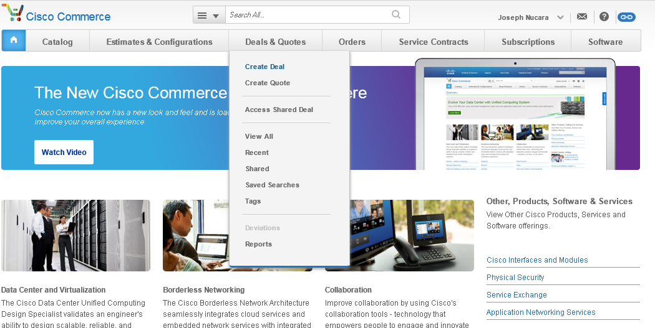
Creating a Deal: Deal Screen
Create a Deal
During this process, you will need to create the framework for your deal including your customer profile.
Log into Cisco Commerce Workspace (valid CCO ID and Password are required)
Select “Deals & Quotes” tab to create deal
Complete mandatory information and click “Create Deal”
Who’s Involved
About the Deal
Incentives
Questionnaire

Slide 40
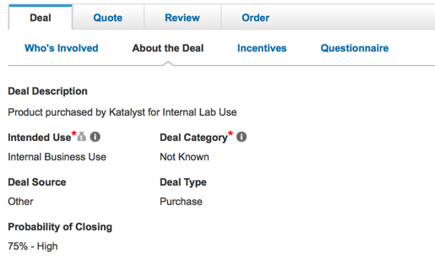
Creating a Deal: Deal Screen
About the Deal
Enter deal name
Verify partner information
Complete all required information in the “About the Deal” tab, including “Intended Use.”
For Infrastructure, choose “Internal Business Use”
For Demo or Lab, choose “LAB”
Click “Create Deal” then “Save and Continue”
Important: For Demo/Lab use, be sure to choose LAB to get the higher discount.
Who’s Involved
About the Deal
Incentives
Questionnaire

Slide 41
Creating a Deal: Deal Screen
About the Deal
Under “Not for Resale” section, the applicable reward will be available for you to select based on your intended use
Remember: Selecting Internal Business Use will populate the NFR Internal Infrastructure reward, while Lab will populate the NFR Demo Lab reward
Click “Save and Continue”
Who’s Involved
About the Deal
Incentives
Questionnaire

Slide 42
Registering a Deal: Deal Screen
Complete Questionnaire
Begin the questionnaire by acknowledging that you understand your yearly purchasing limit
Complete all required fields as designated with red asterisk *
Click “Save and Continue”
Who’s Involved
About the Deal
Incentives
Questionnaire

Slide 43
Registering a Deal: Quote Screen
Discounts and Credits
Add your IWO PID’s to the deal and configure them with the correct Smart Account and Virtual Account information.
Under “Discounts and Credits”, you will see the new NFR discount along with your certification base discount
Click “Save and Continue”
Items
Discounts and Credits
Install
Billing

Slide 44
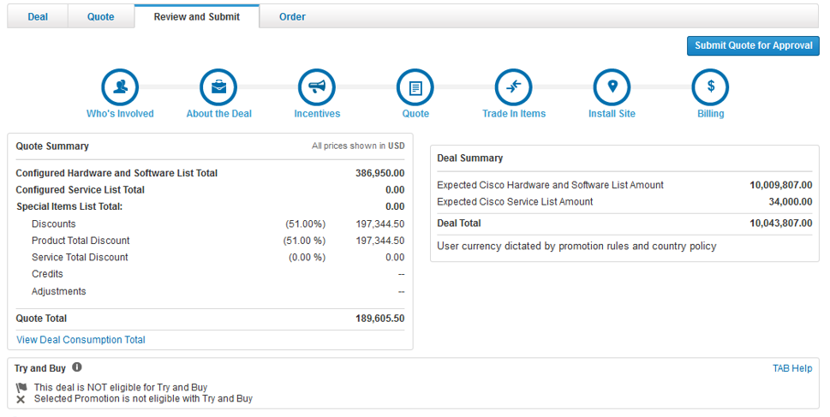
Registering a Deal: Review & Submit Screen
Review & Submit
Click “Submit Quote for Approval” then “Save and Continue”
Note: Your deal will be reviewed by Cisco internal operations and your Partner Account Manager
Reminder: You will be sent a notification once the deal is approved, however you can check on your deal’s progress at any time
Items
Discounts and Credits
Install
Billing

Slide 45
Cisco Intersight Workload Optimizer Internal Lab licenses

Slide 46
Intersight Workload Optimizer – Lab Licenses
Cisco has created a new process to request and receive Cisco IWO Lab software and license file:
Only valid for internal Cisco Employees
Requires valid Smart Account and Virtual Account from Cisco
Internal trainings/Labs and customer demo environments ONLY
Accessible via Smart Demo License Request Portal

Slide 47
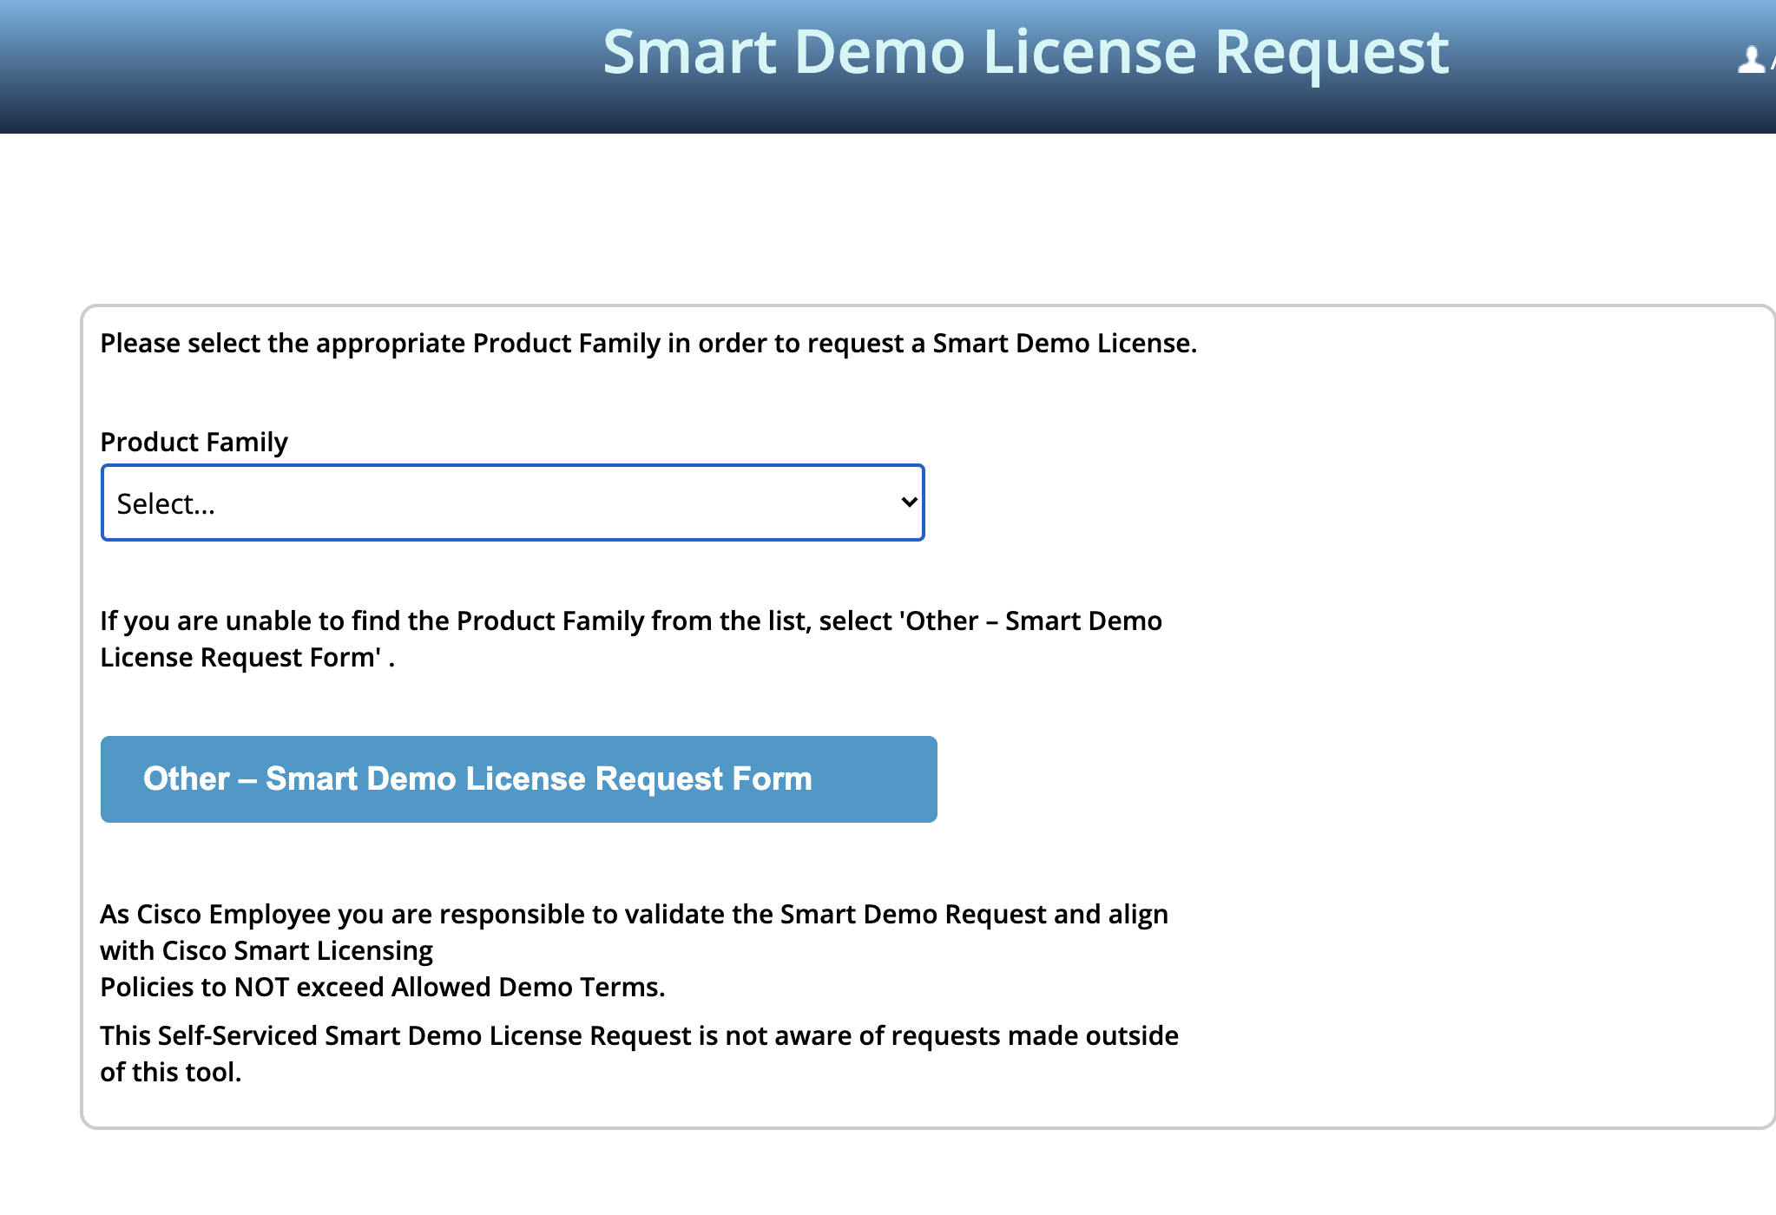
Intersight Workload Optimizer – Lab Licenses
Login to Smart Demo License Request Portal
Select Intersight Workload Optimizer

Slide 48
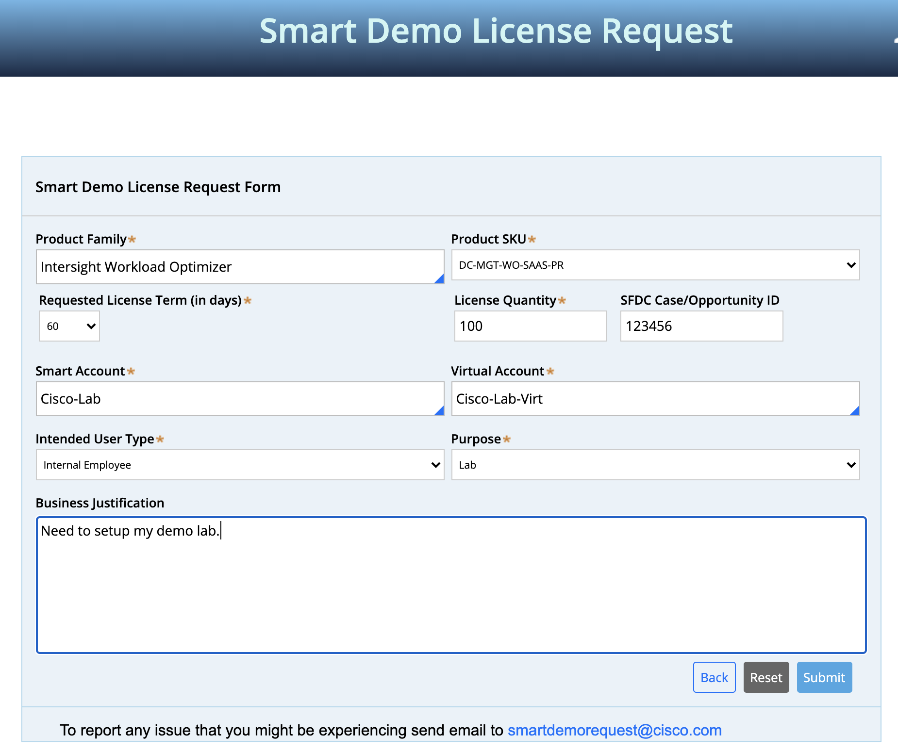
Intersight Workload Optimizer – Lab Licenses
Fill in all fields
Ensure to enter a valid Smart Account and Virtual Account
Submit the Request
Licenses will be added to the Virtual Account provided.

Slide 49
Cisco Intersight Workload Optimizer Discount Restricted Product (DRP) Exception Process

Slide 50
Discount Restricted Product (DRP) Exception
IWO is in the Market Category subscription software model. The result is a discounting structure that requires special attention. This is UNLIKE the Cisco Core or Cisco Data Center pricing models but instead uses a low list price/low discount approach.
Customers that have SRA’s and RNSD pricing agreements in place ARE NOT EXEMPT from this discount structure.
IWO Discounting Structure:
20% Standard Discount
10% OIP (Partner registration required)
Total discount will be either 20% or 30%
There is a VIP program for IWO that Partners can leverage
For further discounting requests, use this DRP process
Reminder: IWO is NOT ELIGIBLE FOR DATA CENTER DISCOUNTING (i.e. 61% etc.)

Slide 51
Discount Restricted Product (DRP) Exception
The steps on the next few slides are required to request discounts greater than the standard 20% Market Category discount or 30% OIP discount level.
Use these steps to request discounts beyond 20% (standard) or 30% (standard + OIP)
Applies to the following offer PIDs:
DC-MGT-SAAS
C1-ECS-WOM
E2-N-CWOM
E2N-MGT-SA-WO-AD
E2N-MGT-SA-WO-PR
E2N-MGT-SA-WOD-AD
E2N-MGT-SA-WOD-PR
Note: Partners registering for OIP in CCW will automatically receive 30% discount (20% standard + 10% OIP)

Slide 52
Discount Exception Process Overview
Scope:
Process for requesting additional discounts (non-standard) above system applied discounts such as Contractual and/or Promotional (ePromo, VIP, SIP..etc) on Discount Restricted Products (DRPs).
High level steps:
STEP 1: Get BU support for your discount and save email for use when submitting DSA
STEP 2: Once you have BU support for your discount, proceed to submit your deal (you cannot change the discount, Commercial Finance will do this once you follow these steps:
STEP 3: Enter the product quantity and duration
STEP 4: Field Sales (AM) clicks “Other Non-Standard Terms” in SFDC
STEP 5: Select “Other N/S Terms” and enter Justification Text
STEP 6: Enter the desired discount for the specified IWO line on BOM and refer to BU Support email (must acquire before submitting deal)
STEP 7: Attach Support email(s) & Submit Quote for Approval. Follow up with Commercial Finance Resources.
STEP 8: Commercial Finance will revise discount and route for approvals (Account Team cannot change discount)

Slide 53
Discount Exception Process Overview
STEP 1: Get BU support for your discount and save email for use when submitting DSA
The CWOM PID is discount restricted, therefore a Cisco AM will not be able to adjust the discount on their own.
ONLY Commercial Finance can do this once you have followed the Discount Exception process outlined here.
Vish Jakka (vijakka) is the BU PM that will support your request and include Adam Lubsen (alubsen) WW BDM for IWO and CWOM
NEW!: The BU will need the following details which you can enter at this URL>>>>: http://cs.co/IWO-CWOM-DRP-Exception
Provide Cisco Deal ID and share access to it
Provide the discount level you are requesting
Is this an a-la-carte quote or part of a DC EA?
Provide an Excel BOM of the deal with discount requested to reflect proposed Cisco selling price
When is this deal expected to close?
Provide a summary of the the current DC business with customer
Provide a summary of the future DC business if the discount is approved and customer purchases
Provide a justification for the discount ask
Provide the Business Impact Presentation (BIP) produced as a result of the POV efforts
Provide any competitive impacts on this deal
Is this going to be a one-time discount request and are you setting expectations with the customer that future orders will have standard Cisco discounting?
Can customer commit to public reference?
Once you get the confirmation of support from the BU, then you can complete the exception process in the quote, attach the email of support and then submit.

Slide 54
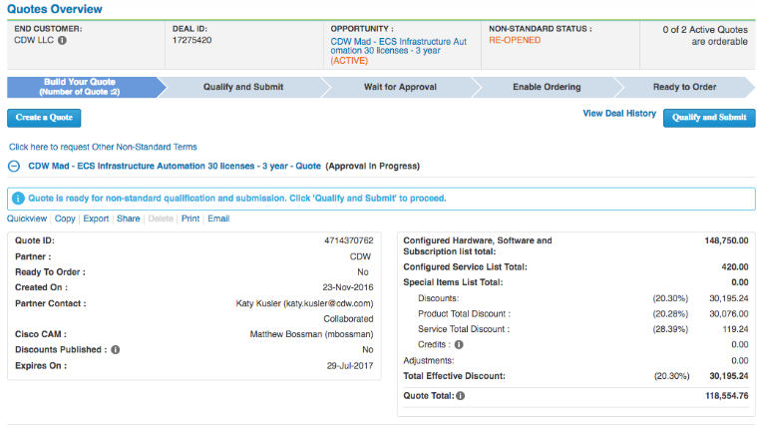
Exception Process Steps
Step 4: Field Sales (AM) clicks “Other Non-Standard Terms” in SFDC
Click on “Click here” to request other Non-Standard Terms

Slide 55
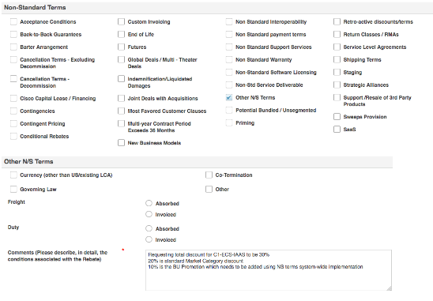
Exception Process Steps
STEP 5 & 6: On the Non-Standard Qualification page, Select “Other N/S Terms” and enter justification text in the Comments box.
Check “Other N/S Terms”
Enter Justification Text including SKUs and Requested Discount.
Refer to BU Support of the discount being requested and reference email attachment
Check “Other”
NOTE: Recommended to copy the SKUs from the Quote where the additional discounts are being requested and paste them into the Comments Box. – see next slide for further guidance.

Slide 56
Exception Process Guidelines
In the comments box, enter the following:
Enter the IWO SKU(s) and the discount being requested.
For incremental discounts, enter the following: “Requesting total discount for DC-MGT-WO-SAAS-AD to be 30%.....” and enter your justification
Be sure to note the correct IWO SKUs
For discounts greater than 20%, be sure to state the reason for the request in the justification section
Get BU Support and be sure to reference and attach to deal before submitting

Slide 57
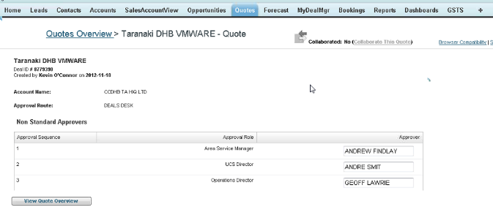
Exception Process Steps
Step 7 & 8: Submit Quote for Approval. Follow up with Regional Finance Approvers

Slide 58
Cisco Intersight Workload Optimizer Deployment Services

Slide 59
Cisco CX Intersight Workload Optimizer Offers
Proof of Value
Quick Start
Use-Case Based
Design and Deployment Service
Kickoff and Pre-requisite Validation
Deploy and Configure Workloads
Add Targets (vCenter, Storage, Fabric)
Run Initial Health Baseline & Report
Execute Actions
Modify & Configure Dashboards
Knowledge Transfer
Pre-packaged AS-T Engagement
Use-Case Based Offers also available including:
Cloud Reclamation and Recovery
Demand Driven Rightsizing
Enhanced Workload Placemen
Health and Value Check
Host Licensing Optimization
On-Prem to On-Prem Migration
On-Prem to Cloud Migration
Optimize Public Cloud
Resource Reclamation and Recovery
Custom Integrations
Cloud Native Kubernetes
8-10 hour remote engagement
Can be pre- or post-sales
Drive Adoption
Provide customer with a guided workshop on IWO
Pre-packaged AS-T Engagement
IWO Business Impact Report also available as an add-on
Custom Engagements
Business Critical Services
Success Track
Custom Engagements available to meet customer requirements including:
Increased scale of targets and workloads
Integration with multicloud solutions
Enhanced reporting
Optimization (Business Critical Services
Ongoing Optimization of Intersight Workload Optimization including Analytics, Insights, and Automation for higher performance and transformation.
Assist customers with:
Best Practices
Ongoing Design Support
Health Checks
Knowledge Transfers
Utilizes a use-case guided approach to drive adoption of core product and solutions.
Uses for IWO include:
Simplified Operations
Workload Optimization
Will be available when Data Center Compute Success Track GA’s
Notes:
David Stanford and Eric Charlesworth in the CX organization have developed offers that closely align those that Turbonomic delivers today –
There are a number of offers that range from “free” sessions for IWO/CWOM customers that are like “ask the expert” and recorded “how to” videos for customers to help with adoption all the way up to comprehensive custom engagements.
We are funding up to 10 PoVs with CX in the Americas to test this out – if you have a PoV in mind, please reach out to me and I can get that started

Slide 60
CX Resources:
CX Cloud and Compute Product Management Page:
https://cisco.sharepoint.com/sites/CXCCIOTProductManagement
CX IWO Franchise Kit:
https://cisco.sharepoint.com/sites/CXCCIOTProductManagement/SitePages/Cisco-Workplace-Optimizer-Manager-(CWOM).aspx
Contacts (Questions and Business Development)
cx-iwo-services@cisco.com

Slide 61
Cisco Intersight Workload Optimizer SFDC Tagging

Slide 62
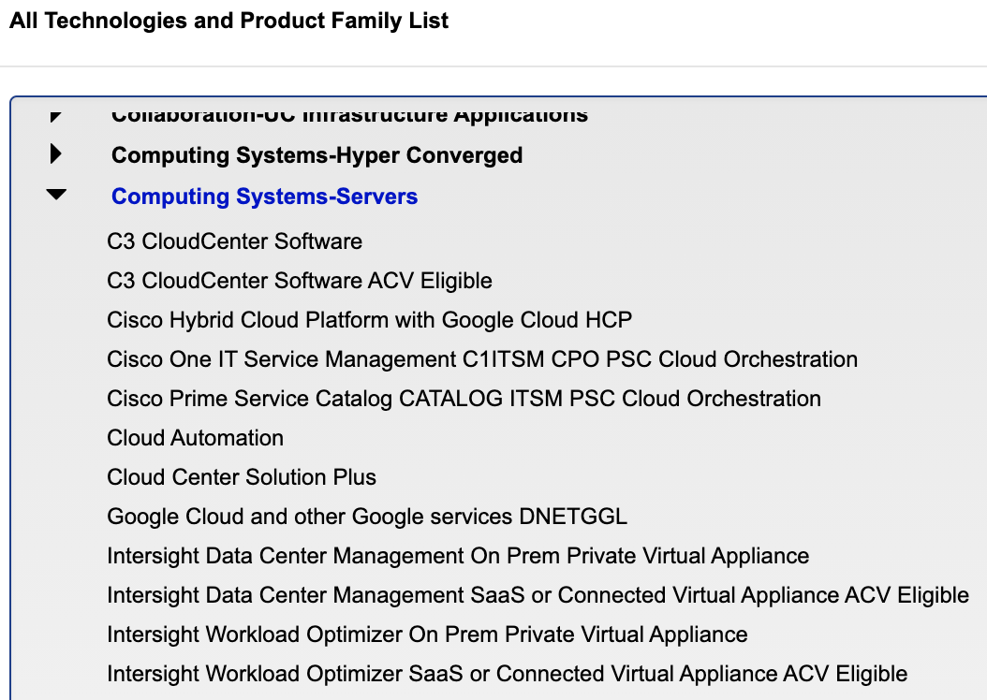
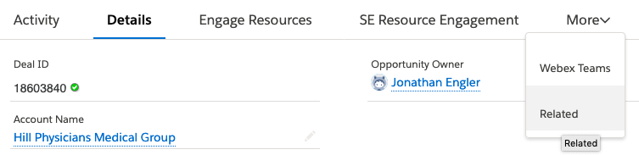
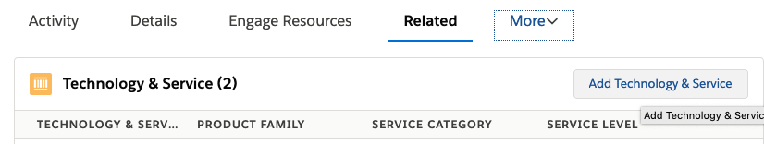
Tagging IWO opportunities in SFDC – AM or PSS
**Note: This will happen automatically if CCW quote is integrated
Use Opportunity page
Click on “Related” tab
Click on “Add Technology & Services”
Select Technology = “Computing Systems-Servers”
For IWO select “Intersight Workload Optimizer SaaS or Connected Virtual Appliance ACV Eligible”
Select “Related”
Select “Add Technology & Services”

Slide 63
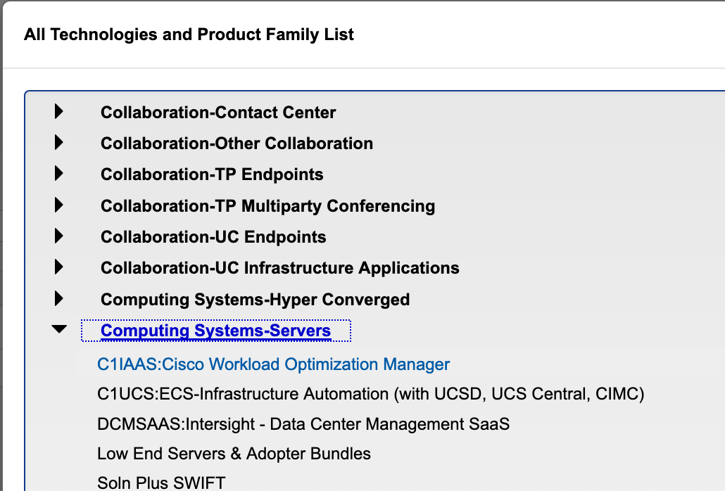

Tagging CWOM opportunities in SFDC – AM or PSS
**Note: This will happen automatically if CCW quote is integrated
Use Opportunity page
Click on “Related” tab
Click on “Add Technology & Services”
Select Technology = “Computing Systems-Servers”
For CWOM select “UCSMKT - Cisco Workload Optimization Manager (CWOM)”
Select “Related”
Select “Add Technology & Services”
DO NOT SELECT

Slide 64
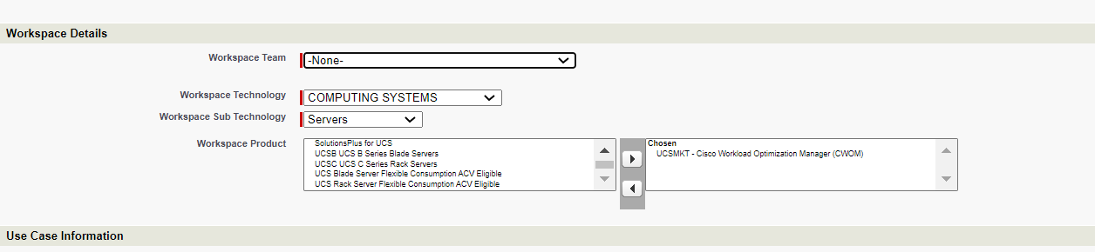
Tagging CWOM opportunities in SFDC – PSS*
In the Workspace Details section:
Workspace Technology = COMPUTING SYSTEMS
Workspace Sub Technology = Servers
Workspace Product = select UCSMKT Cisco Workload Optimization Manager (CWOM) and move to the right box
* Available for Americas Only

Slide 65
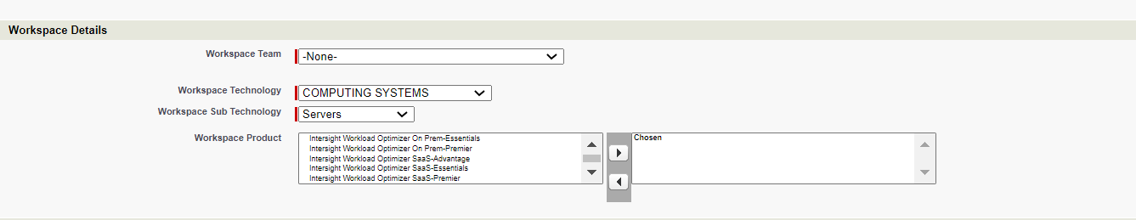
Tagging IWO opportunities in SFDC – PSS*
In the Workspace Details section:
Workspace Technology = COMPUTING SYSTEMS
Workspace Sub Technology = Servers
Workspace Product = select one of the following choices and move to the right box
Intersight Workload Optimizer On Prem-Essentials
Intersight Workload Optimizer On Prem-Advantage
Intersight Workload Optimizer On Prem-Premier
Intersight Workload Optimizer SaaS-Essentials
Intersight Workload Optimizer SaaS-Advantage
Intersight Workload Optimizer SaaS-Premier
* Available for Americas Only

